Slide 1
Pulmonary diseases
Pathophysiology:
Presented by Katie Mathern
October 28th, 2019

Slide 2
Objectives
Broad Outcome
  At the end of the teaching presentation, the learner will be able to identify the basic pathophysiological processes behind various pulmonary diseases.
Specific Objectives
  The learner will be able to differentiate between obstructive and restrictive pulmonary disorders.
  The learner will be able to illustrate various pulmonary diseases including pathological processes and clinical manifestations.
  The learner will demonstrate positive, active engagement in learning the materials presented during the teaching presentation

Slide 3
Pulmonary system
Anatomy and physiology review

Slide 4
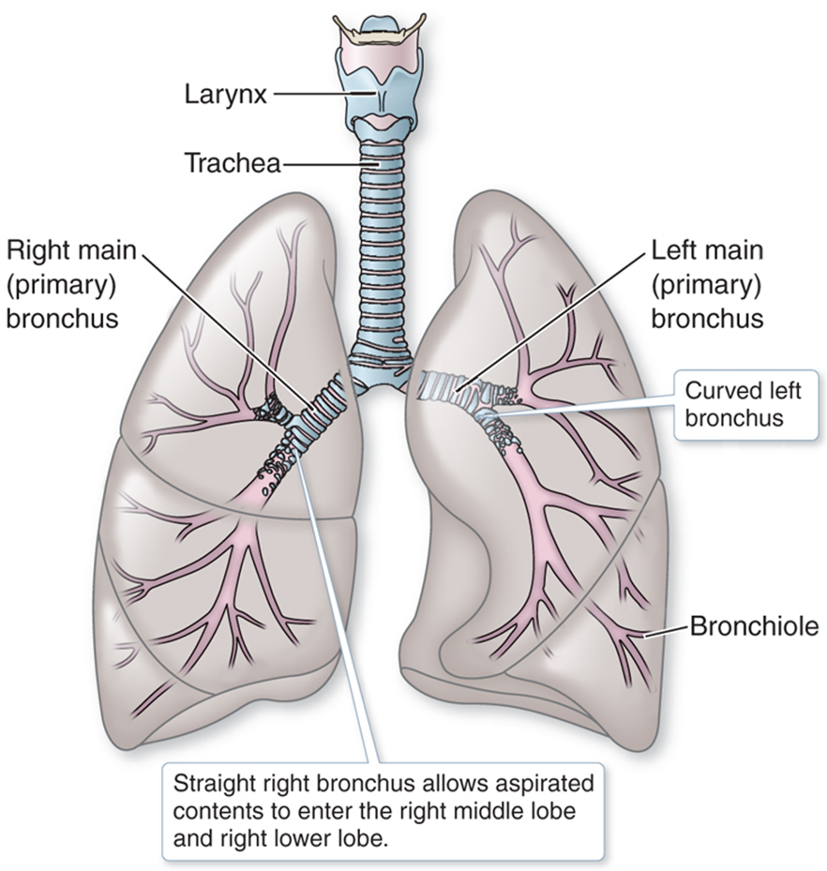
Anatomy & Physiology
Essentially, the function of the lungs is to take blood and put oxygen in it.
Oxygen comes into the lungs from the atmosphere and carbon dioxide leaves the lungs and out of the body. This happens with every breath.

Slide 5
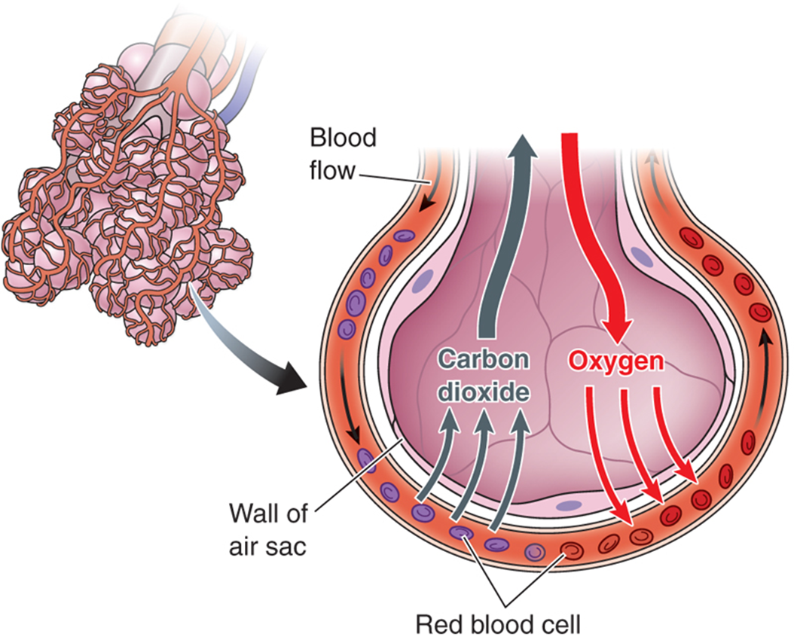
Anatomy & Physiology
This exchange of oxygen and carbon dioxide takes place in the alveoli.
Oxygen attaches to the heme portion of hemoglobin, is taken throughout the body to the tissues where it is exchanged for CO₂ and carried back to the lungs to be expelled.
This process is called respiration.
Notes:
We breath in oxygen (21% room air) ; it combines with the hemoglobin, taken to tissue level where it is released, and then CO2 reattaches to heme molecule which is carried back to lungs and expelled through respiration.
The alveoli are very thin walled air sacs surrounded by capillaries. The thin walls allow for easy transport of oxygen and carbon dioxide across the barrier for gas exchange and respiration. This happens through pressure gradients and simply physics. There is more oxygen in the alveoli so it will diffuse through the capillary into the bloodstream; and there is more carbon dioxide in the bloodstream so it will diffuse through the capillary and into the alveoli

Slide 6
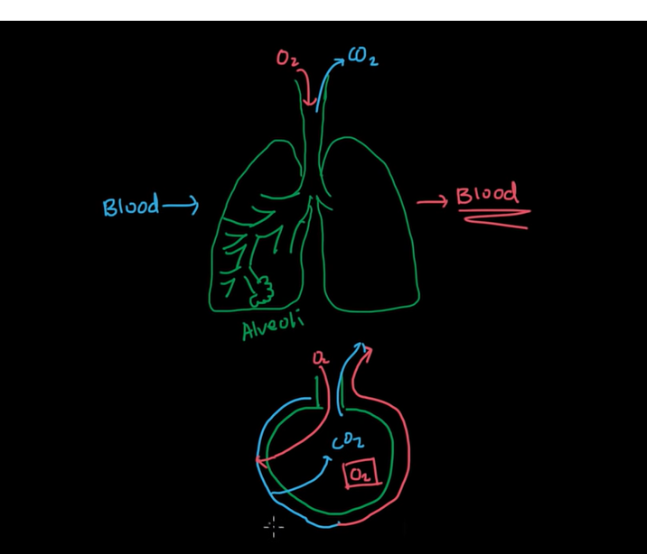
Anatomy & Physiology
Ventilation
The process of inspiration and expiration
Perfusion
The movement of blood through the circulation providing oxygen to every part of the body
Oxyhemoglobin
PaO₂ 90-100mm Hg optimal
PaO₂ < 60 mmHg causes hypoxia
Stimulus to breath
High CO₂ levels
Notes:
Hypoxia means there are insufficient oxygen levels in the blood to meet the needs of the tissue.
In patients with chronic hypercapnia, the stimulus to breath changes to low oxygen levels, which is referred to as a hypoxic drive. One common disease is emphysema (keep their sats 88-92%, otherwise their stimulus to breath will be inhibitied.

Slide 7
Pulmonary disorders
Obstructive and restrictive disorders

Slide 8
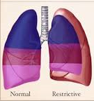
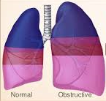
Problems in getting
Restrictive
Obstructive
Problem with lung expansion/ reduction in lung volume
Problem with airway functionality/ reduction in airflow
Notes:
This is a pair of disorders that usually go together. They are opposite of each other as one has a stiff lung unable to take air in, and the other results in wasted space within the lung spaces that leads to air trapping.
Restrictive – not getting air in (hypoxia) and obstructive, not getting carbon dioxide out (hypercapnia)
This is a global view of the lungs and their ability to get air in and out.

Slide 9
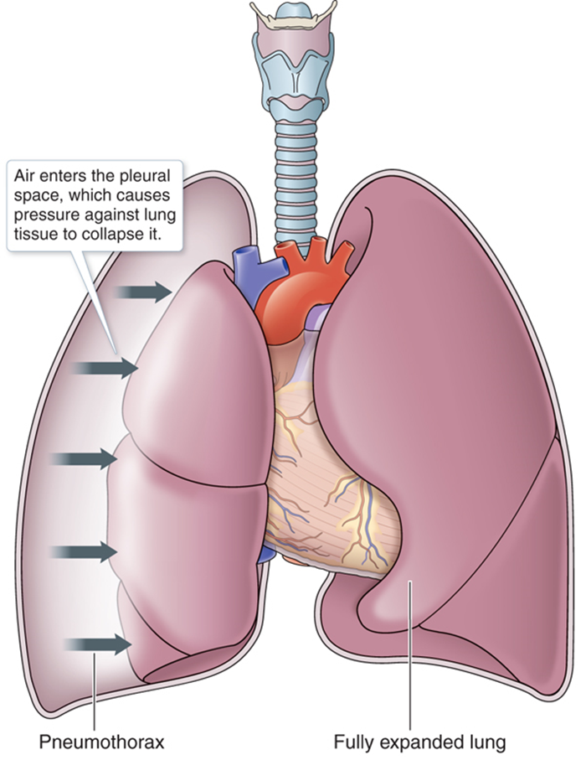
Restrictive disorders
Diseases which prevent complete ventilation, diminish total lung capacity, and impede the opening of the alveoli.
Pneumothorax
Pleural effusion
Lung diseases which cause damage to the lung tissue
Musculoskeletal disorders
Immunological-mediated disorders
Neurological disorders
Notes:
This inadequate ventilation causes a lot of dead space within the lung space.
Basically there is something wrong with the lungs that is making it hard to expand.
Fibrosis = stiff tissue (cannot expand) sarcoidosis, amyloidosis (genetic) amiodarone toxicity
Patients will present with HYPOXIA

Slide 10
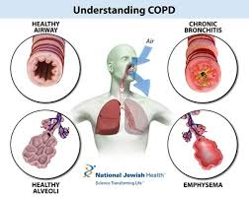
Obstructive disorders
Diseases which impair airflow. Usually we think of “trapped air” in the lung, but obstructive diseases also include hyperreactive airway disease, aka asthma.
COPD
Asthma
Mucous Plugging
Bronchiectasis
Obstructive Sleep Apnea
Notes:
Obstructive – instead of letting the lung collapse back into normal size (elasticity of the alveoli) the air is essentially “stuck”. Patients cannot exhale properly.Different reasons – mucous plug (air can’t escape) or the walls collapse – air can’t recoil out. Large, overinflated lungs. Imagine how difficult it would be to not be able to exhale? How uncomfortable?
COPD is a mixture of two different diseases (emphysema – loss of elasticity; chronic bronchitis – irritation causing increased mucous production)
Asthma causes constriction of the bronchioles causing airways to spasm and close up, blocking the air from getting out.

Slide 11
Pulmonary disorders
Problems with gas exchange

Slide 12
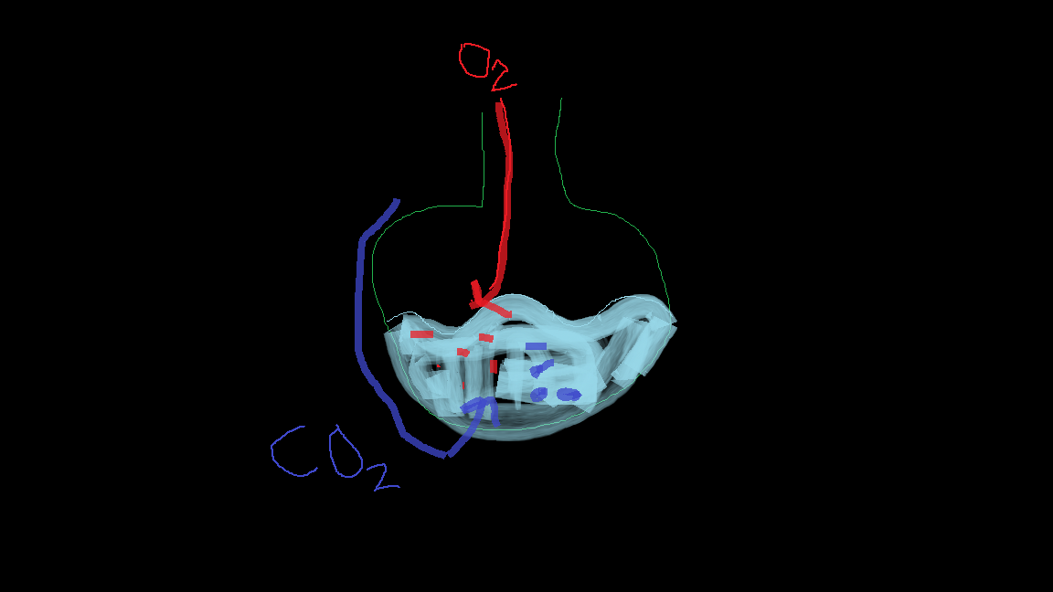
Impaired gas exchange
Disease processes which cause the alveoli to be filled up with fluid causing difficulty for gas exchange.
Atelectasis
Pneumonia
Pulmonary Edema
Notes:
It is much more difficult for air to pass through liquid than it is a thin permeable membrane (normal alveoli).
There is much less oxygen available to the tissues, and the patient becomes hypoxic as well as hypercapnic. This can lead to respiratory failure.
What causes this? Infection (common) pneumonia – think of inflammatory process – swelling, phagocytes, fluid shifts, mucous production. Pulmonary edema (heart failure, left ventricular failure).
Gas exchange = “wet lungs”

Slide 13
Pulmonary disorders
Problems with perfusion

Slide 14
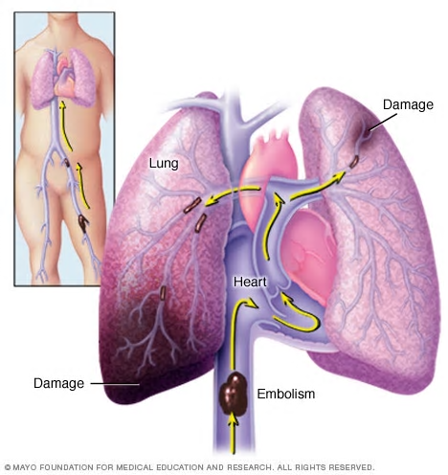
Problems with Perfusion
Disorder characterized by inadequate blood supply to the alveoli.
Pulmonary emboli
  Usually develops from a DVT
  Causes dead space – and manifests as an abnormal ventilation-perfusion ratio (V-Q ratio).
Notes:
If the gas exchange problems are “wet” lungs, the problems with perfusion are almost “too dry”. There is no blood supply!
What this is, its a clot that lodges in the pulmonary arterial circulation. Caused by an obstruction of arterial blood flow through the lungs, remember that the right ventricle pumps to the lungs so an embolism has originated on the venous side and it travels up to the inferior vena cava into the right atria, right ventricle and then the embolus travels to the lung and lodges in the pulmonary circulation

Slide 15
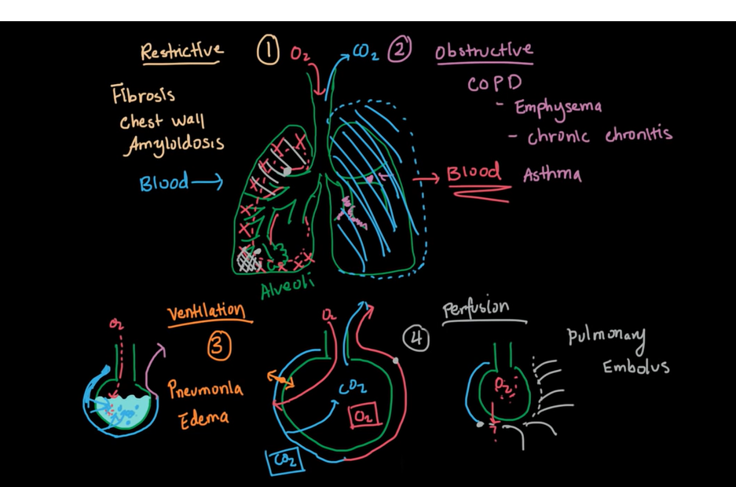
Overview of pulmonary disorders
Notes:
This is a very basic overview of the pulmonary disorders that will give you some structure as to the specific disease patterns and how they cause problems with oxygenation and perfusion.

Slide 16
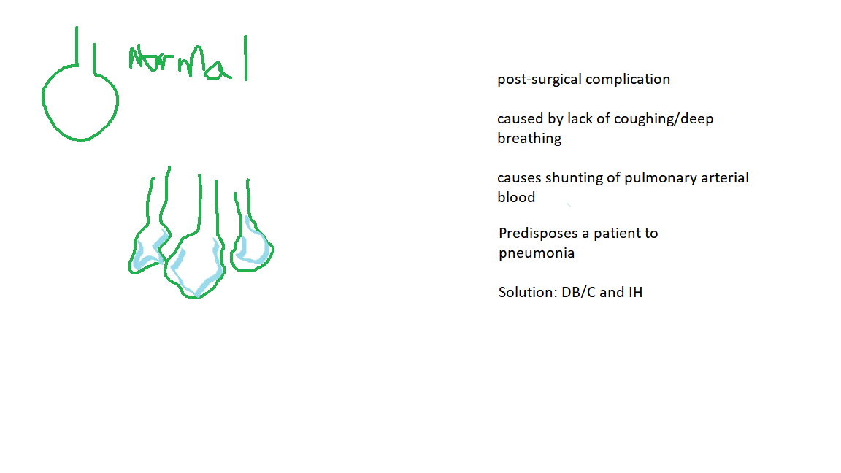
Group activity: pictionary
Students will partner up into groups of 4 and be assigned a pulmonary disorder.
Groups will have 5 minutes to create an illustration and five “hints” about risk factors, clinical manifestations, or complications related to the assigned disease process.
Each student group will come in front of the class and have 1 minute to convey the topic to the class
Winning groups will be able to brag about their pathophysiology teaching abilities for the rest of the classroom time allotted for pulmonary content!
Notes:
Answer: Atelectasis

Slide 17
references
Awadh, F. (2014). Obstructive vs. restrictive lung disease. [Powerpoint]. Retrieved from https://www.slideshare.net/FatimaAwadh/obstructive-vs-restrictive
Capriotti, T., & Frizzell, J.P. (2016). Pathophysiology: introductory concepts and clinical perspectives. Philadelphia, PA: F.A. Davis company.
Kahn academy (2019). Nclex-rn: respiratory system diseases. Retrieved from https://www.khanacademy.org/test-prep/nclex-rn/rn-respiratory-system-diseases
Make, B.J., & Petrache, I. (2016). COPD overview. National jewish health. Retrieved from https://www.nationaljewish.org/conditions/copd-chronic-obstructive-pulmonary-disease/overview
Mayoclinic, inc (2019). Pulmonary embolism. Retrieved from https://www.mayoclinic.org/diseases-conditions/pulmonary-embolism/symptoms-causes/syc-20354647

