Slide 1
Debate as a Teaching Strategy: Appreciating Opposition
Katie Mathern, RN, BSN, PCCN
February 11th, 2019

Slide 2

Debate is not about being argumentative, it is about discussing an issue from opposing positions or arguments (Bradshaw & Hultquist, 2017).
Pixabay, 2019
Notes:
Politicians use debate as an avenue to make their positions known on relevant social and political issues.
Unfortunately, google images of debate and you get pictures of angry politicians!

Slide 3
Broad Outcome
At the end of the 20 minute oral presentation, the learner will be able to discuss the advantages of using debate as a teaching strategy and reflect upon topics which will enhance learning in the classroom setting.

Slide 4
Objectives
At the end of the 20 minute oral presentation, the learner will be able to:
  Identify three benefits of using debate in the classroom as a teaching strategy.
  Participate in a respectful mini-debate on the topic of DNR in the OR.
  Reflect upon relevant healthcare topics to integrate as a debate activity in the classroom setting.
Notes:
Promotes critical thinking and engages learners at Bloom’s highest level of learning including analysis; Enables the student to build and practice communication skills; Promotes the flipped classroom and active learning strategies to engage students of different learning backgrounds
Group exercise
Should Prescriptions Drugs be able to be advertised on TV directly to the consumer? (promotes medical-seeking but may ask for inappropriate drugs and pressure provider); Abortion (not in undergrad – too emotional!); Should routine amniocentesis be performed; Medical marijuana – iffy subject for undergraduate, need to know your people….

Slide 5
Contrasting Teaching Methodologies
Lecture
Debate
Pedagogical approach to learning
Student is a passive learner
Andragogical approach to learning
Student is an active learner
Enhances verbal communication of the learner
Notes:
Both lecture and debate can introduce new topics and points of view to a large number of learners.
However, the main differences between the two methods are outlined here

Slide 6
Why Use Debate?
Aligns with QSEN competencies
Promotes high-level thinking
Can be used as an assessment tool
Embodies a flipped classroom
Notes:
QSEN: (1)patient-centered care; (2)teamwork and collaboration; (3)evidence-based practice; (4)quality improvement; (Safety and Informatics could be topics, not objecives)
Critical thinking in all Domains of Learning.
In the academic setting, debate can foster active learning. Learners research he topic and come armed with knowledge and proof to advocate for their “side”; learners need to be active in the debate to give voice to their feelings; learners will learn more about their attitudes and beliefs about controversial topics and gain confidence in their ability to make informed and educated decisions.
Can the student analyze the evidence, synthesize the information, and advocate for a viewpoint (Hartin, Birks, Bodak, Woods, & Hithcins, 2017)
Preparation done beforehand so that synchronious in person classroom can be used for active learning and engagement.

Slide 7
Advantages
Disadvantages
Promotes student engagement and livens up classroom curriculum (EducationWorld, 2019).
Incorporates utilizing research skills
Expands a student’s knowledge and perspective on an issue
Improves oral communication
Intense preparation
Under-preparation may lead to superficial discussion instead of in-depth debate (Bradshaw & Hultquist, 2017).
Potential for emotionally charged environment
Anxiety to the learner related to public speaking
Notes:
The process of engaging in debate helps students to build oral communication skills, express a professional opinion, and gain experience in public speaking (Bradshaw & Hultquist, 2017).
Flipped Classroom: first advantage
Research Skills – use reliable and valid sources to make informed decisions, it isn’t just about opinions on subjects.
Cognitive Domain – expands a student’s knowledge base
Oral Communications - Professionals should be able to articulate a thoughtful and research-based opinion on salient issues. In addition to having a supported opinion, professionals also need to have knowledge of the opposing viewpoints in order to defend and support their own opinions, especially if the topic is controversial. Students need to be taught how to have respectful communication and be confident in having an opinion that differs from someone elses.
Intense Preparation – flipped classroom downside
Controversial topics – be prepared to be neutral. If the facilitator can’t handle the emotional strain from the topic, do not have it up for debate
Public Speaking – build upon. Facilitator can lend support for the (not popular) viewpoint to bring out good points. Use reflection to validate points.

Slide 8
Tips for Educators
Be prepared
Remain neutral
Impart clear objectives
Provide support as needed

Slide 9
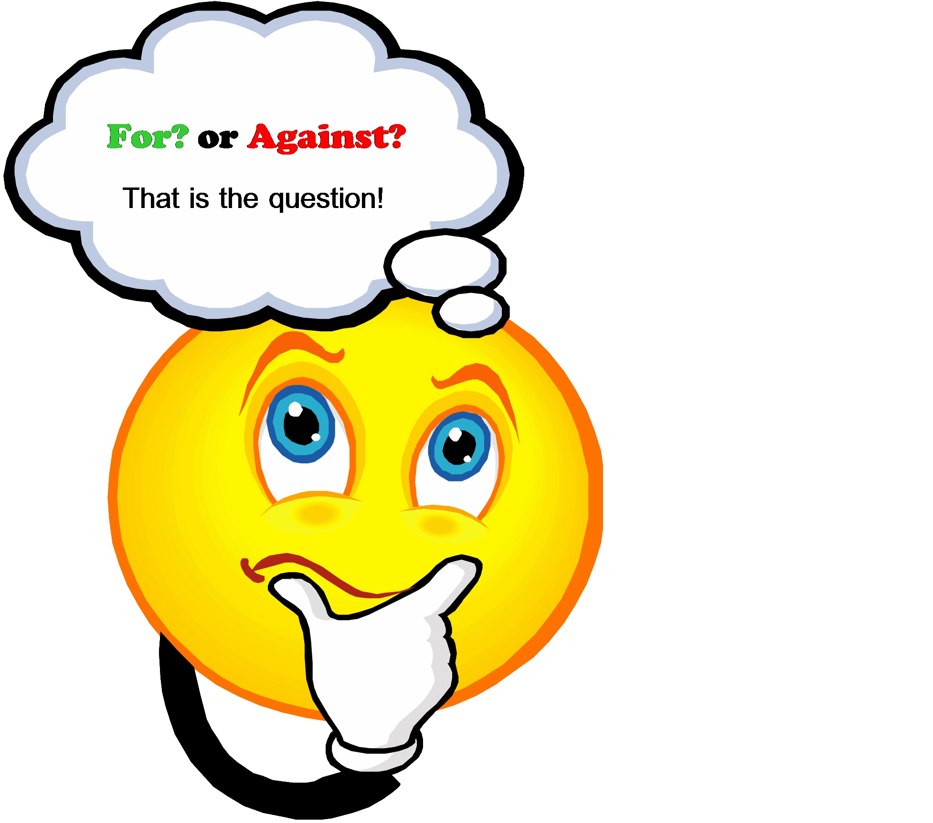
Let’s Debate!
DNR in the OR: Who Decides When to Save a Life?

Slide 10
DNR in the OR: Who Decides When to Save a Life?
Ground Rules:
No discussion outside of arguments, cross examination, or audience discussion
All discussion will remain respectful
The facilitator will intervene as necessary in the case of unprofessional attitudes or behaviors

Slide 11
DNR in the OR: Who Decides When to Save a Life?
Directions:
Participants will be assigned an affirmative or negative viewpoint and have 1 minute each to impart their viewpoint to the audience, affirmative position first.
Participants will have a 30 second rebuttal to cross the opposing viewpoints, affirmative first.
Participants then have 30 seconds in closing arguments, negative first.
Audience members will have 1 minute to engage in discussion and offer viewpoints.
Reflection. Each person in attendance will perform a quick self-reflection on how the debate strengthened previous knowledge about the subject and which position they were persuaded to take based on the debate presentation and personal values.

Slide 12
Affirmative Viewpoint
DNR should be suspended during surgery for full resuscitation measures
  Anesthesia can impair breathing patterns and cause cardiac dysrhythmias that can be reversed with drugs and measures that are not deemed extraordinary in the OR setting.
  Patients may not understand the risks and treatment options

Slide 13
Negative Viewpoint
DNR should not be suspended in the OR.
  Patient autonomy
  Patient’s right to self-determination
  Advance Directives should be followed as they are made in sound mind and are legal precedents for healthcare providers to follow

Slide 14
Reflection
Who won the debate?
Why?
What went well?
What could have gone better?
Is this topic important in healthcare and could you give an educated opinion after this debate?

Slide 15
Post-Test
What are three QSEN competencies supported by debate?
How does debate support the psychomotor domain of learning?
True or False. By forming an opinion from analyzing the research and listening to opposing views, the learner is engaged in the affective domain of learning.
True or False. Debate is a good innovative teaching strategy because there is always a clear right and wrong answer.
True or False. Abortion is a great debate topic for undebecause it is controversial and a well-known topic.
Name two relevant healthcare issues that may be suited for debate in the classroom
Notes:
Critical thinking; oral presentation skills; ability to form a professional opinion.

Slide 16
References
Bastable, S.B. (2019). Nurse as educator: Principles of teaching and learning for nursing practice (5th ed.) Burlington, MA: Jones & Bartlett Learning
Bradshaw, M.J., Hultquist, B.L. (2018). Innovative teaching strategies in nursing and related health professions (7th ed.). Burlington, MA: Jones & Bartlett Learning
EducationWorld (2019). Debates in the classroom. Retrieved from https://www.educationworld.com/a_curr/strategy/strategy012.shtml
Hartin, P., Birks, M., Bodak, M., Woods, C., & Hitchins, M., (2017). A debate about the merits of debate in nurse education. Nurse Education in Practice, 26, 118-120.
QSEN. (2019). QSEN Competencies. Retrieved from http://qsen.org/competencies/pre-licensure-ksas

